Slide 1
Cognitive Interviewing
Theory:
How do I conduct cognitive interviews?
Olivia Sexton, Sophie Pilley, Jo d’Ardenne and Richard Bull
https://www.ncrm.ac.uk/resources/online/all/?id=20816

Slide 2
Overview
Understand different cognitive interviewing techniques
How to design an effective interview protocol
analysis of cognitive interview data

Slide 3

Cognitive interview techniques
The key elements of a cognitive interview are:
  Administering the question
  Observation
  Think aloud
  Probing

Slide 4

Administer the question
The test questions should be asked in a realistic context
If testing a ‘face-to-face’ survey questions should be read out aloud by the interviewer
If testing a self-completion survey participants should read questions themselves

Slide 5

Observation
Any hesitations?
Any signs of frustration or boredom?
Do participants ask for help at any point?
Do they change their answers at any point?
Do they skip any part of the task?

Slide 6
Observation Probes
Any hesitations?
Any signs of frustration or boredom?
“Can you tell me what you are thinking?”
Do participants ask for help at any point?
Do they change their answers at any point?
“I noticed you changed your answer- why was that?”
Do they skip any part of the task?
“I noticed you skipped this question- why was that?”

Slide 7
Think-aloud
Aim:
Train
Demonstrate the technique to the participant. Get them to give you a demonstration back.
Remind and encourage
“Can you tell me what you are thinking?”
“Keep talking…”
“You’re doing really well!”
To get respondent to verbalise their thought process

Slide 8
Probing
General | Comprehension | Retrieval | Judgement | Response
How did you go about answering that question? Was that easy or difficult to answer? Why? | Could you tell me in your own words what this question is asking? What did you understand by ‘X’ when answering? | How easy or difficult was it to remember that? What time period were you thinking about? | Did you give an exact answer or did you make an estimate? How accurate do you think this answer is? | How easy or difficult was it to find the answer you were looking for from the options provided? Are there any answers missing from the options provided?

Slide 9
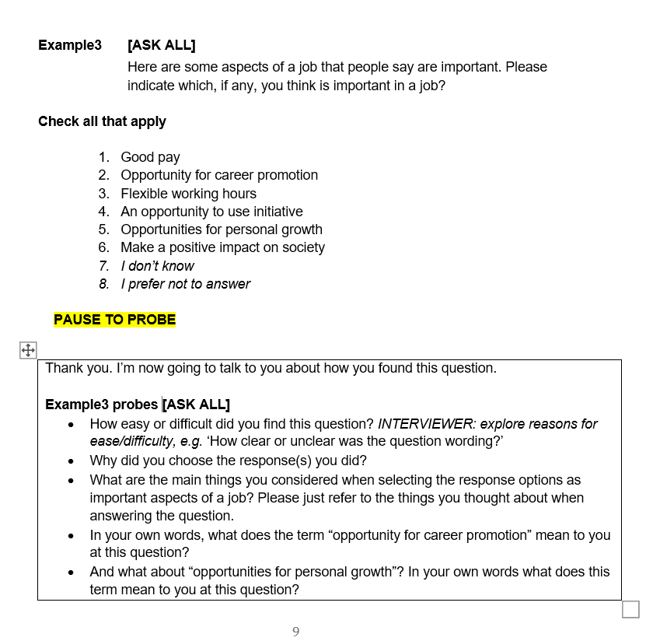
Developing interview protocols

Slide 10
Developing interview protocols
Remember: Interviews are semi-structured.
Protocols are guides not scripts.

Slide 11

Effective protocols
Clear introduction
Include aims of testing
Neutral and open probes
Consider probe placement
Relevant to question testing
Mode of interview

Slide 12
Effective protocols
Clear introduction
Include aims of testing
Neutral and open probes
Mode of interview

Slide 13
Effective protocols
Clear introduction
Include aims of testing
Neutral and open probes
“How easy or difficult did you find that?
Why? Can you give examples?”
Consider probe placement
Mode of interview

Slide 14
Effective protocols
Clear introduction
Include aims of testing
Neutral and open probes
Consider probe placement
  Concurrent
  Retrospective
Mode of interview

Slide 15
Effective protocols
Clear introduction
Include aims of testing
Neutral and open probes
Consider probe placement
Mode of interview
  Face-to-face
  Remote: video + screen share

Slide 16
Analysis of cognitive interview data
Summarising each case
Combining case level summaries
Thematic analysis
Drawing conclusions

Slide 17

Case summaries
Response to the question being tested
Observations
Summary of issues raised

Slide 18
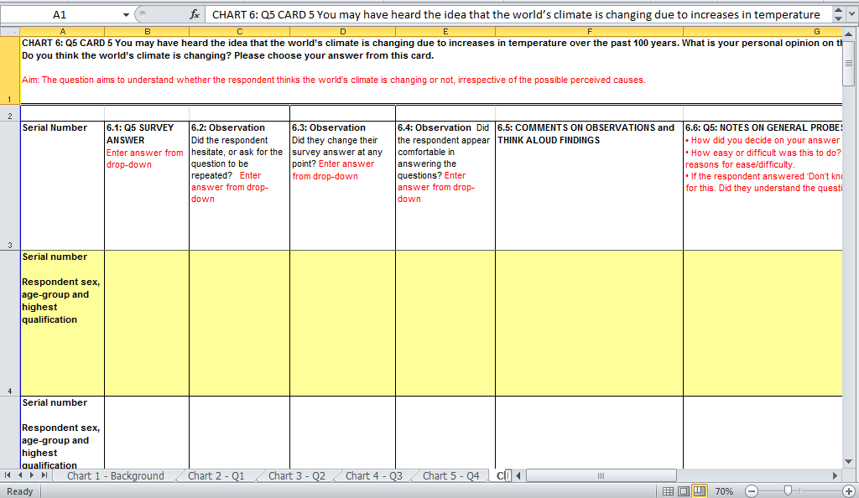
Combining summaries from multiple cases

Slide 19
Thematic analysis
Familiarisation with charts
Categorisation and labelling of each issue
    is issue X of the same as Y or is it different?
Summarise issues occurring for each question:
Three types of issue were identified with Q1: X, Y and Z
Note: The aim is to describe each issue not quantify each issue

Slide 20

Drawing conclusions
Why has this issue occurred?
Three types of issue were identified with Q1:
1. Requests for the question to be repeated
2. Lack of understanding of the term ‘X’
3. Missing response options

Slide 21
Drawing conclusions
Why has this issue occurred?
Three types of issue were identified with Q1:
1. Requests for the question to be repeated
2. Lack of understanding of the term ‘X’
3. Missing response options
What is the impact of this issue?

Slide 22
Drawing conclusions
Why has this issue occurred?
Three types of issue were identified with Q1:
1. Requests for the question to be repeated
2. Lack of understanding of the term ‘X’
3. Missing response options
What is the impact of this issue?
Options? Solutions?

Slide 23
Now we have learnt about how to conduct cognitive interviews to test survey questions
The next part of the course will discuss:
Other situations where cognitive interviews can be used…

